Slide 1
Best Practices in Transit Rider Survey Data Collection
Chris Tatham
Sr. Vice President, CEO, ETC Institute
725 W. Frontier Circle
Olathe, KS 66061
913-254-4512
ctatham@etcinstitute.com
May 11, 2011

Slide 2
Agenda
Challenges with On-Board Data Collection
Methods to Address the Challenges
Use of Personal Interviews/Tablet PCs
GPS-Based Boarding/Alighting Counts
Use of GIS-Based Edit Check Programs
Data Expansion at the Stop/Segment Level
Questions

Slide 3
Challenges
Quality of the Data
Accuracy of address information (origins, destinations, and home addresses)
Accuracy of boarding/alighting locations
Accuracy of transfers
Missing information (income and other key demographics)
Distribution of the Sample
Major stops along a route under-represented
Short-trips under-represented
Key demographic groups under-represented
Methods to Address the Challenges
Questions

Slide 4
1. Tablet PCs and Personal Interviews
Advantages of Personal Interview
More accurate
More complete
More representative
key groups are not under-represented
Advantages of Tablet PCs
Details about the study area/transit system can be pre-programmed
Less time to administer (helps capture short trips)
Less time between data collection in the field and implementation

Slide 5
Tablet PC vs. Self Administered
Combined results of pilot tests in Atlanta (2009),
Phoenix (2010), and Nashville (2011)

Slide 6
Reasons Tablet PCs Enhance Data Quality and Sampling
Tablet PCs can be programmed with information to improve the quality of the data collected
Route location and stops pre-loaded
Transfers along the route are pre-loaded
Street names and major attractions/destinations are pre-loaded
Methodology enhances the representativeness of the sample
Skip patterns reduce the length of the survey, which helps ensure that short-trips are represented
Persons who cannot read and others who may not be able to complete a paper survey are included

Slide 7
How Tablet PCs Work in the Field

Slide 8
How Tablet PCs Work in the Field
Bus route numbers
pulled from the GIS layer
shown on a dynamic map
later in the survey

Slide 9
How Tablet PCs Work in the Field

Slide 10
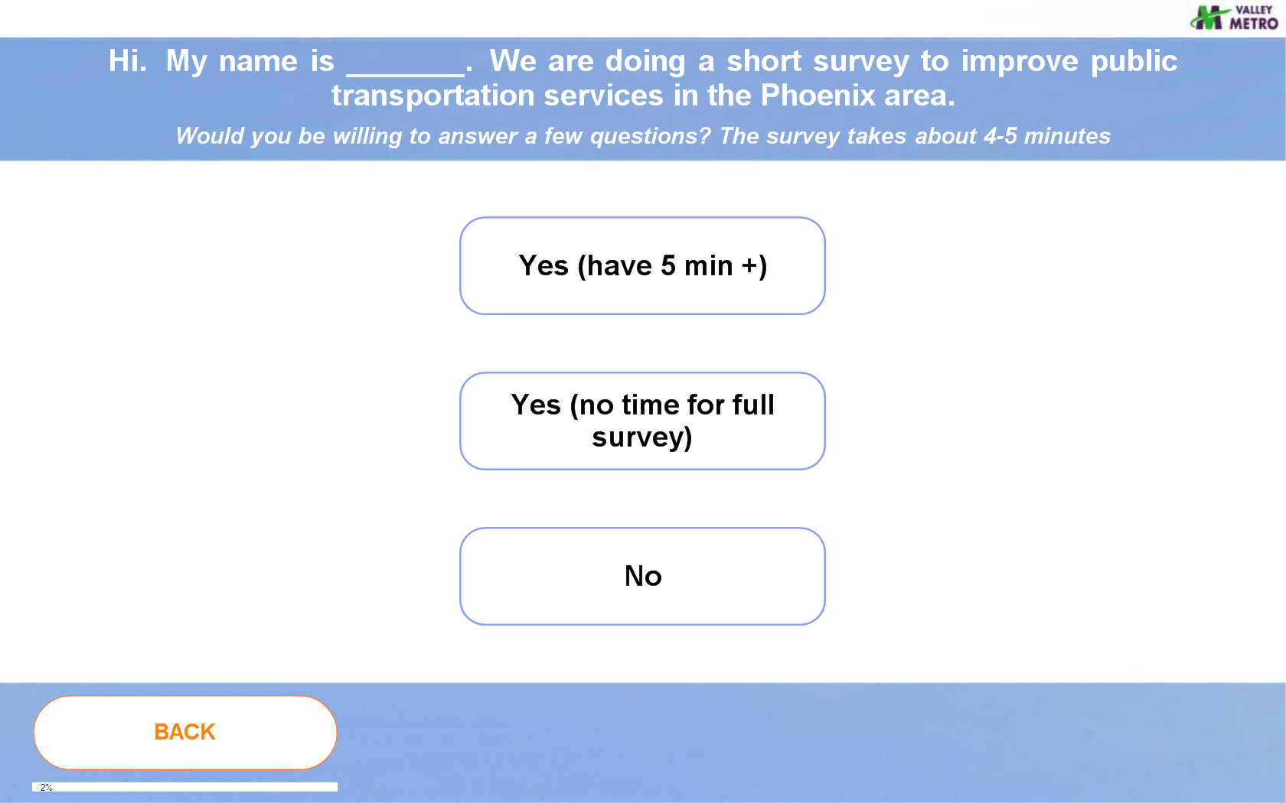
How Tablet PCs Work in the Field

Slide 11
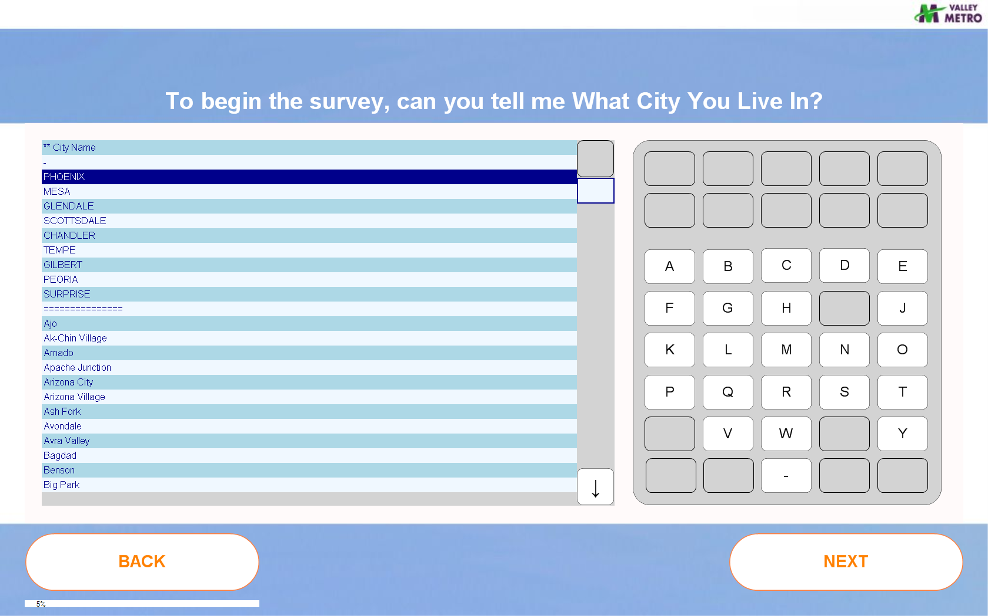
How Tablet PCs Work in the Field

Slide 12
How Tablet PCs Work in the Field

Slide 13
How Tablet PCs Work in the Field

Slide 14
How Tablet PCs Work in the Field
Zoomed-in.
Selected stop flagged in
yellow. Stop ID, coordinates,
and name saved to
survey record.

Slide 15
How Tablet PCs Work in the Field
Zoomed-in.
Selected stop flagged in
yellow. Stop ID, coordinates,
and name saved to
survey record.

Slide 16
2. GPS-Based Boarding/Alighting Counts
Improves accuracy of the boarding and alighting locations
Helps agencies locate the actual boarding location if good stop address information is not available
Build accurate stop lists for specific routes
Helps link boarding and alighting counts with survey data ‘

Slide 17
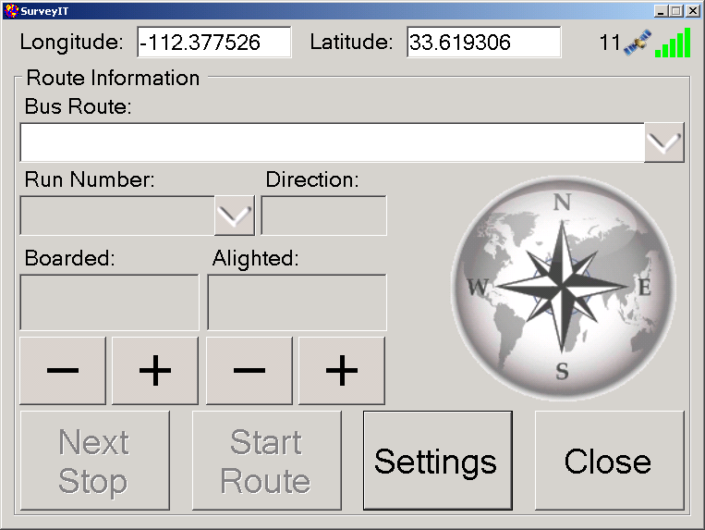

Slide 18
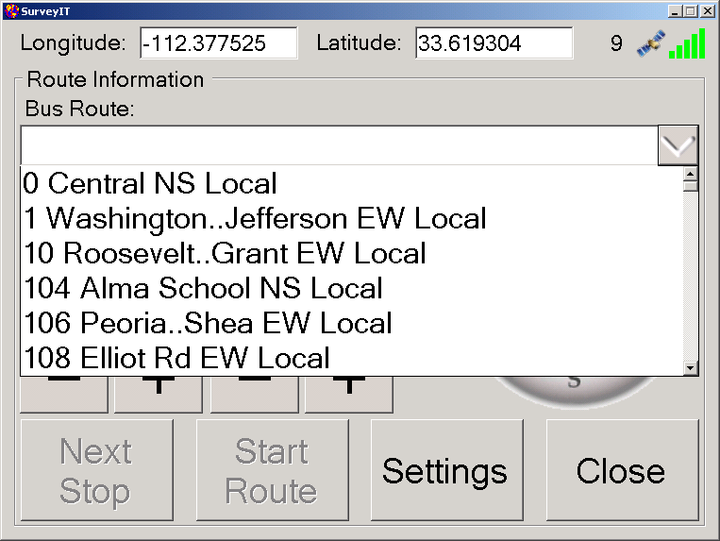

Slide 19
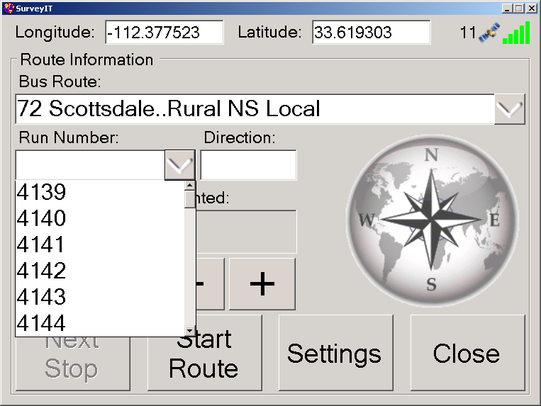

Slide 20
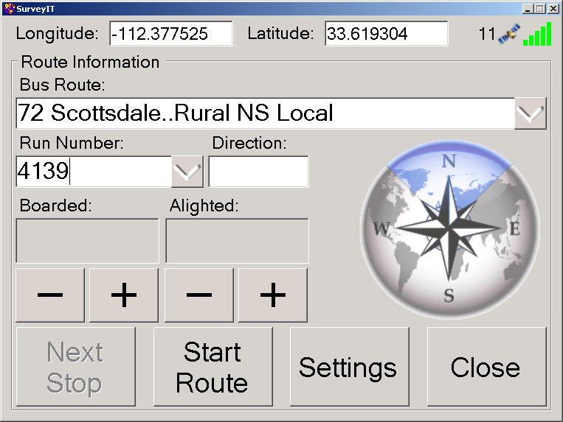

Slide 21
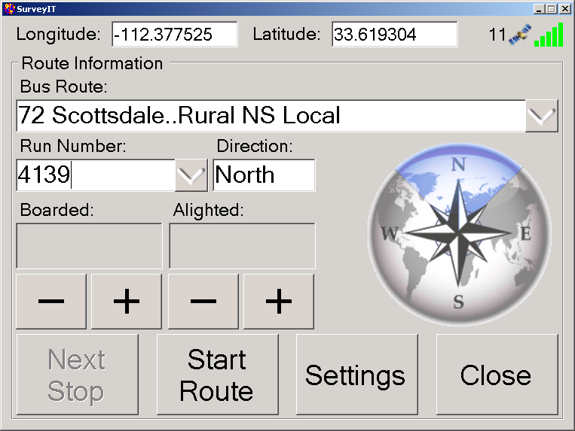

Slide 22
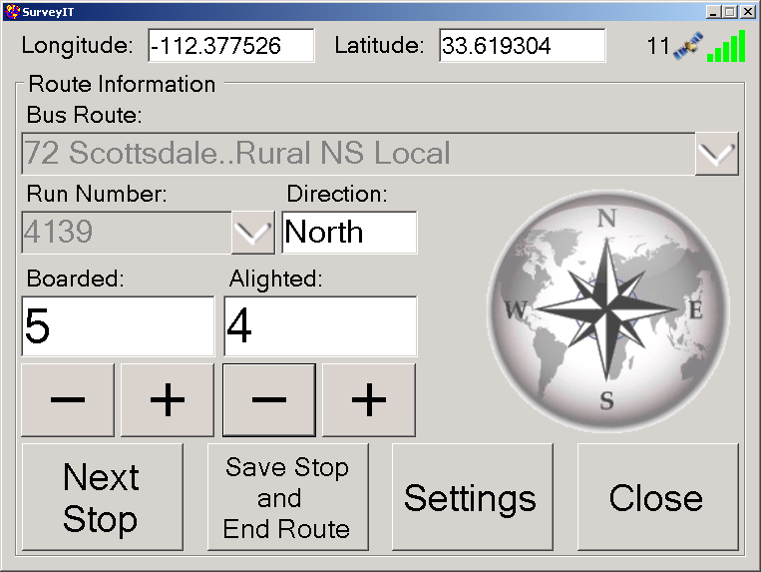

Slide 23
Results are saved in a database table as well as individual “Stop” files. A continuous GPS log is also saved for the trip.

Slide 24
3. GIS Based Edit Check Programs
Following the collection of the survey data in the field, GIS-based edit checks allow you to check the logic and accuracy of the data collected
Allows Visual Review of:
All key points on the trip (home, origin, boarding location, alighting location, and destination)
Transfers
Mode of travel relative to the access/egress distances
Travel distance on transit compared to the total length of the trip

Slide 25
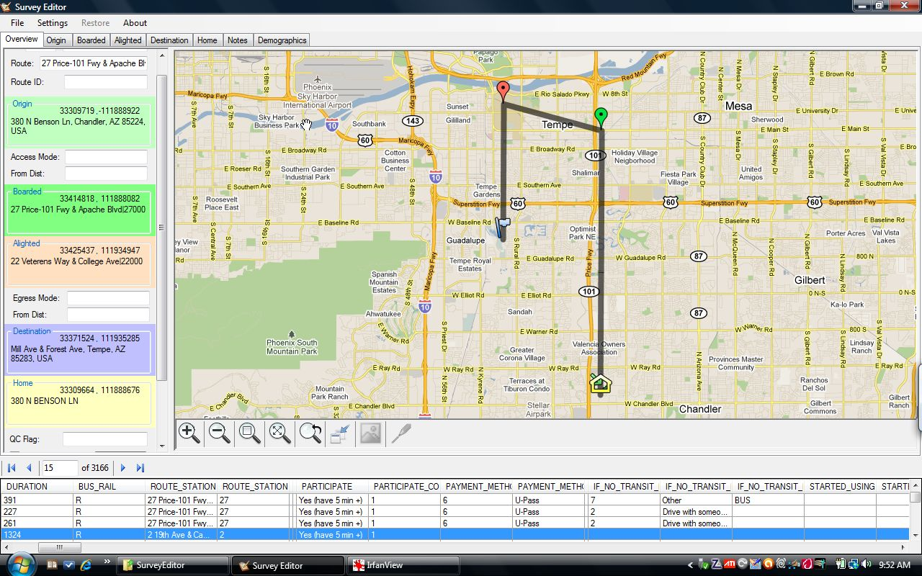
Edit Check Programs Interface with Google to Allow Accurate Trip Corrections

Slide 26
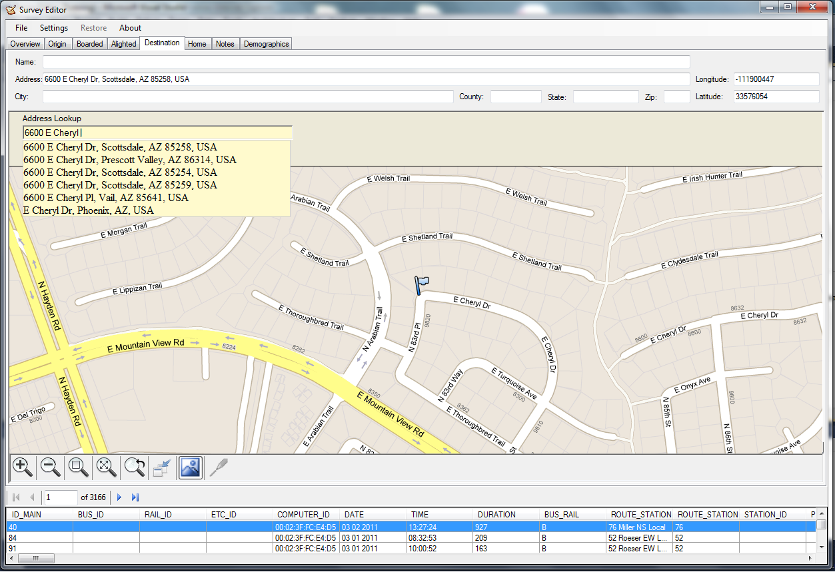
Edit Check Programs Interface with Google to Allow Accurate Trip Corrections

Slide 27
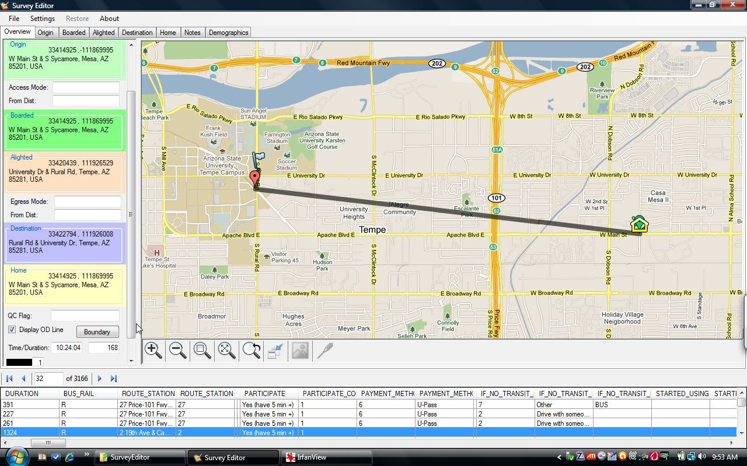
Edit Check Programs Interface with Google to Allow Accurate Trip Corrections

Slide 28
4. Data Expansion By Stop/Segment
Traditional methods expand data by direction and time of day
Problems can result if the distribution of the sample is not representative of the actual ridership along the route
Too many surveys are often collected at the end of the line or places where the respondents have more time to complete the survey
If the locations of boardings are not adjusted to the actual boardings at key stops along a route, data expansion will only multiply the poor distribution obtained in the field.

Slide 29
4. Data Expansion By Stop/Segment
METHODOLOGY
Relies on accurate boarding and alighting counts at the stop/station level
Requires a good locational distribution of surveys in the field
Bus Expansion
By Time of Time
By Direction
By Location
Each route divided into major stops/segments
Rail Expansion:
By Time of Day
By Direction
By Path (BOARDING STATION to ALIGHTING STATION)
29

Slide 30
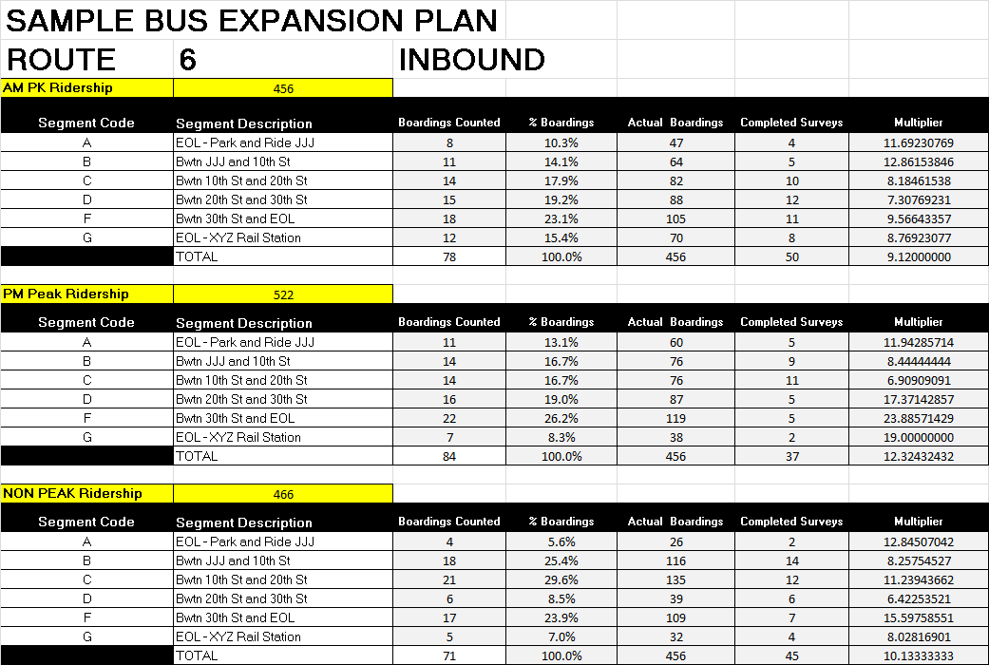
Data Expansion - BUS

Slide 31
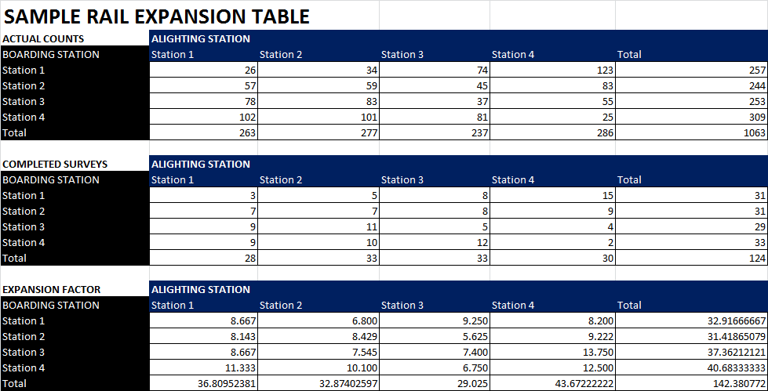
Data Expansion - RAIL
31

Slide 32
Summary
Good on-board transit survey data collection starts with good training and oversight of the people administering the survey.
Once the basics are in place, the methods discussed today can be used to enhance the overall quality of the data collected
Table PCs
GPS-Based Boarding/Alighting Counts
GIS-Based Edit Check Programs
Data Expansion at the Stop/Segment Level
The practical application of these techniques will be impacted by budget

Slide 33
Questions ???

